Slide 1

Relational Db Structure / Anomalies
.NET

Slide 2
A Relational Database is made up of a collection of tables that each store a specific set of structured data. A table contains a collection of rows (tuples) and columns (attributes). Each column in the table stores a certain type of data.
https://docs.microsoft.com/en-us/sql/relational-databases/databases/databases?view=sql-server-ver15

Slide 3
Relational Database – Concepts https://www.tutorialspoint.com/dbms/relational_data_model.htm
Tables − “relations” are saved in table format. This format stores the relation among entities. A table has rows and columns, where rows represent entities and columns represent attributes.
Tuple − A single row of a table, which contains a single record for that entity is called a tuple.
Relation schema − A relation schema describes the relation name (table name), attributes, and their names.
Primary Key − Each row has one (or more) attributes, chosen as Primary keys. These identify the row in the table uniquely.
Composite Key – Multiple Candidate Keys that together form the Primary Key.
Index – A unique number given to each tuple in a table to serve as the Primary Key.

Slide 4
RDBMS - Benefits https://www.tutorialspoint.com/dbms/dbms_overview.htm
Relation-based tables − A Relational DBMS allows tables to store related data in the form of entities that can be queried and combined.
Separation of the data (the state) and the application − A database is logically separated from the data it holds. A database is an active entity, whereas data on which the database works is said to be passive.
Less redundancy − DBMS follows rules of Normalization. Normalization splits a relation when any of its attributes has redundancy.
Consistency − Consistency is achieved where every relation in a database is persisted.
Query Language − DBMS (or RDBMS) has a query language (usually SQL), which makes it more efficient to retrieve and manipulate data.
ACID Properties − A DBMS follows the concepts of Atomicity, Consistency, Isolation, and Durability.
Isolation Levels − A DBMS supports a multi-user environment and applies restrictions on the access and manipulation of data in parallel.

Slide 5
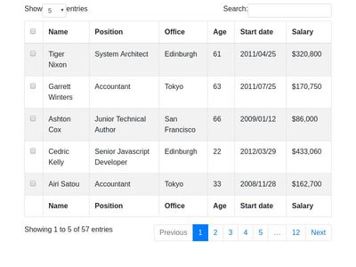
Databases – Instances/Users https://docs.microsoft.com/en-us/sql/relational-databases/databases/databases?view=sql-server-ver15
There are one or more schemas within a database.
Within each schema there are database objects such as tables and views.
This is a table. →→→→→
Foreign Key
A row(Tuple) makes up an entity
Primary Key
Attributes / Candidate Keys

Slide 6
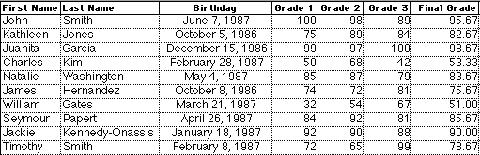
Database Management System (DBMS) https://www.tutorialspoint.com/dbms/dbms_overview.htm
Data is a collection of facts and figures that can be processed to produce information.
A Database is a collection of data that is related by its characteristics.
A Database Management System (DBMS) stores data so it’s easy to insert and retrieve.
If you have the grades of all students, you can easily extrapolate average grades, highest grades, GPA, etc.
Primary Key
*Not a good example!

Slide 7
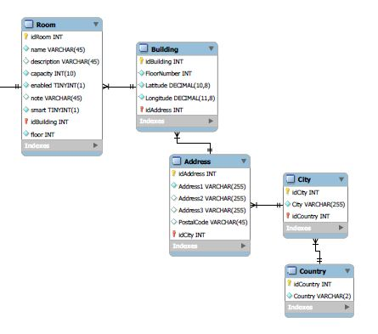
Database Schema Diagram https://www.tutorialspoint.com/dbms/dbms_data_schemas.htm https://en.wikipedia.org/wiki/Data_modeling
A database schema is the skeleton structure that represents the logical view of the entire database. It defines how the data is organized and the relations among them.
It displays all the constraints that are to be applied on the data.
A schema diagram contains a descriptive detail of the database.

Slide 8
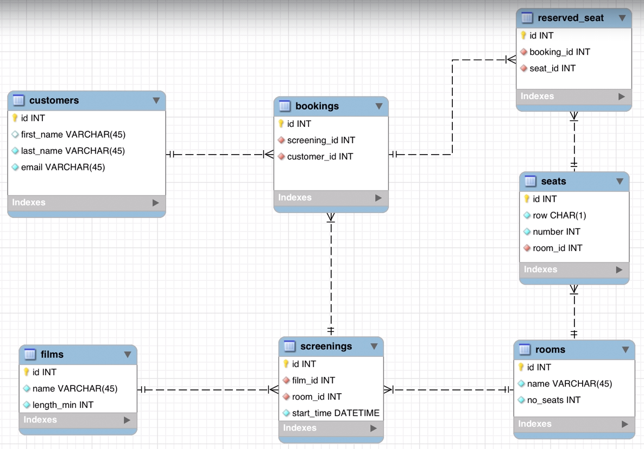


Database Schema Diagram https://www.tutorialspoint.com/dbms/dbms_data_schemas.htm https://en.wikipedia.org/wiki/Data_modeling
Red Color means FK
Solid Shape == NOT NULL Constraint
Empty Color Outline == NULL
Golden key == PK
Red Key == FK (also a PK in another table).
Blue Diamond == NOT NULL Constraint
Red Diamond == NOT NULL and is a FK.

Slide 9
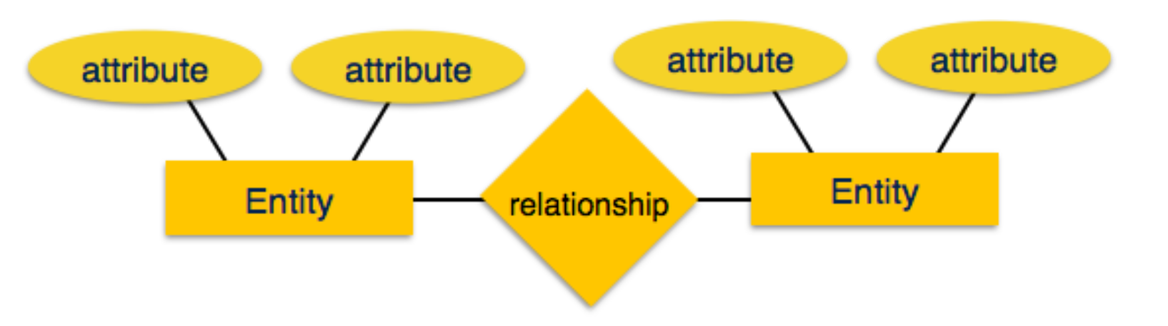
Entity-Relationship Models https://www.tutorialspoint.com/dbms/dbms_data_models.htm https://en.wikipedia.org/wiki/Data_modeling
Data models define the structure of a database. Data Models are entities that abstract the data from a DBMS into a more human readable format. Data models define how data is connected to each other and how they are processed and stored inside the database.
An Entity-Relationship (ER) Model is based on the notion of real-world entities and the relationships between them. An ER Model is used for the conceptual design of a database.

Slide 10
Entity-Relationship Models https://www.tutorialspoint.com/dbms/dbms_data_models.htm https://en.wikipedia.org/wiki/Data_modeling
Entity − a real-world thing having properties called attributes.
Attribute - the details about an entity.
Relationship − The logical association between entities. Relationships are mapped with entities in 3 ways.
“Mapping cardinalities” defines the number of associations between two entities.
Mapping cardinalities
one to one (1-1)
one to many (1-N, N-1)
many to many (N-N)
Address
Sports
Teachers
Principal
Students
attends
School
Can this ER Model be more normalized?

Slide 11
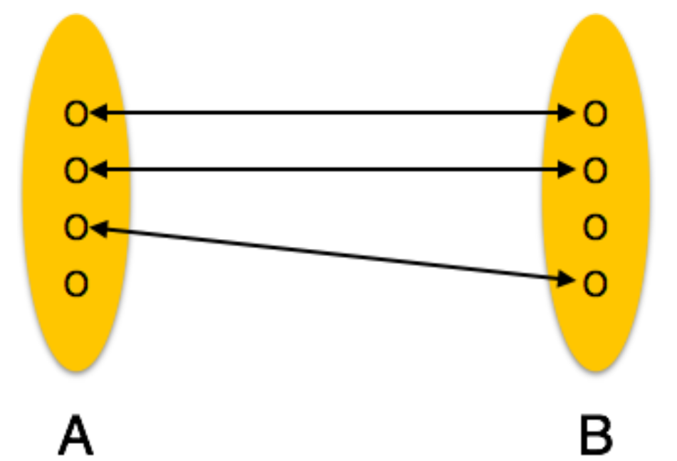
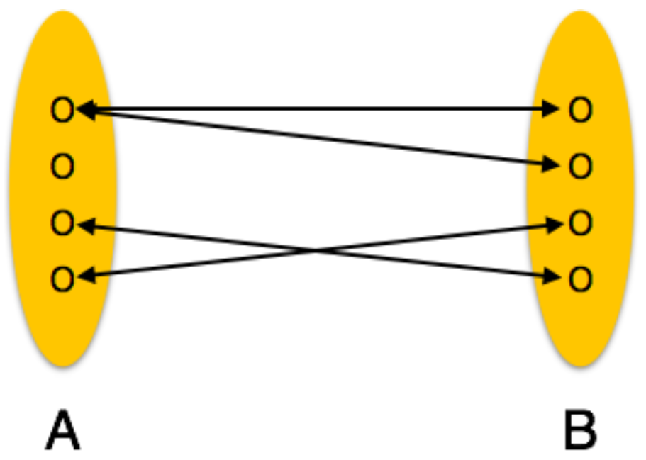
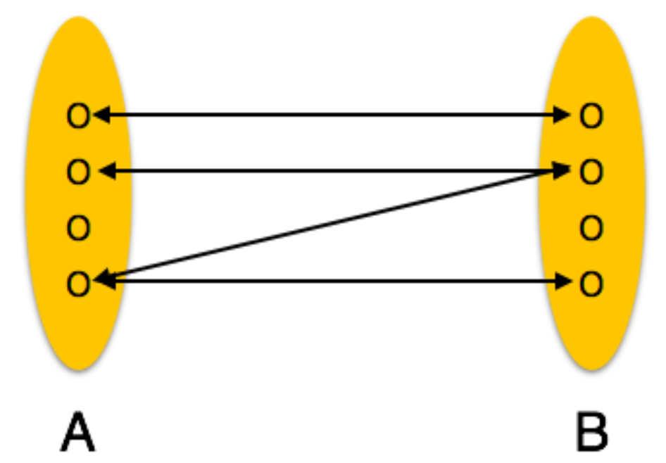
Relational Database – Relationships https://www.tutorialspoint.com/dbms/er_model_basic_concepts.htm
Multiplicity
One-to-one | One-to-many | Many-to-many
One entity from entity set A can be associated with at most one entity of entity set B and vice versa. | One entity from entity set A can be associated with more than one entities of entity set B. However, an entity from entity set B can be associated with at most one other entity | One entity from A can be associated with more than one entity from B and vice versa. Use a Cross-Reference Table.

Slide 12
Cardinality vs Multiplicity https://martinfowler.com/bliki/MultiplicityNotCardinality.html https://www.tutorialspoint.com/dbms/er_model_basic_concepts.htm
When data modeling methods talk about relationships, they use the term cardinality to indicate how many entities may be linked together. You might have a relationship between order and customer and say that the cardinality of the relationship is one-to-many. Or you might hear that the cardinality of customers for an order is 0-to-many.
UML avoids the term cardinality preferring to use multiplicity. Often people with a data modeling background are surprised at this since cardinality has been so widely used in data modeling circles.
The reason for the change is that the dictionary definition of cardinality is "the number of elements in a particular set or other grouping" (OED). According to this the data modeling usage is actually wrong. In the excellent UML Reference Manual, Rumbaugh defines multiplicity as "A specification of the range of allowable cardinality values - the size - that a set may assume". The UML uses multiplicity in various places, for a property (association or attribute) and also to show the multiplicity of parts in a composite structure. It's formally defined as a lower and upper bound. An association (the UML equivalent to a relationship in data modeling circles) has a multiplicity for each direction.

Slide 13
Primary and Candidate Keys https://www.tutorialspoint.com/dbms/er_model_basic_concepts.htm https://docs.microsoft.com/en-us/ef/core/modeling/keys?tabs=data-annotations
Candidate Key − An attribute of an entity. An entity set may have more than one candidate key.
Primary Key − A Candidate Key chosen to uniquely identify the entity set(tuple).
Foreign Key – The Primary Key of another table. Used to represent to other entity.
Foreign Key
A Tuple makes up an entity
Primary Key
Attributes / Candidate Keys

Slide 14
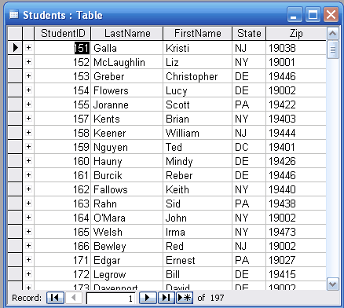
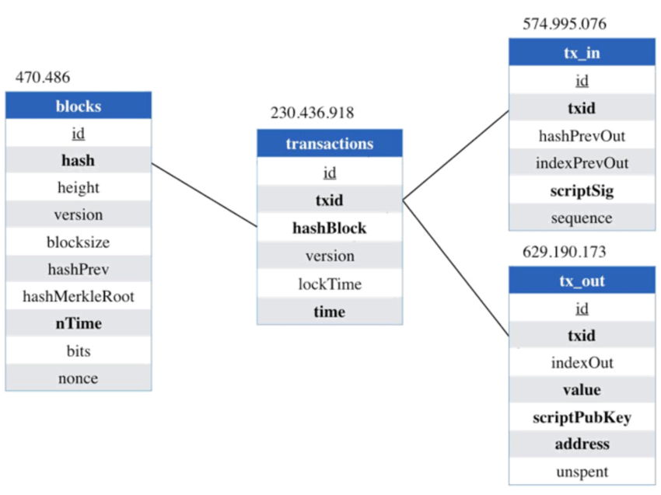
Relational Database https://en.wikipedia.org/wiki/Relational_database#RDBMS
A RDBMS allows entities to form tables with relations between them. You could ideally understand the architecture of a database just by looking at the table names.

Slide 15
Relational Database Constraints https://www.tutorialspoint.com/dbms/relational_data_model.htm
Key Constraints | Domain Constraints | Referential Integrity Constraints
Candidate Keys must uniquely identify an entity. A Candidate Key can not have NULL values. | Every attribute must have a specific range of values. | A Foreign Key refers to a Primary key of a different table. If a tuple has a Foreign Key, that PK must exist.

Slide 16
Databases – Anomalies https://www.tutorialspoint.com/dbms/database_normalization.htm
If a Database has inconsistent data, it will incur anomalies. A DB with anomalies can give inconsistent data.
There are three types of anomalies:
Update anomaly − If data items are not linked to each other properly, when one data item is updated, a few instances may get updated properly while a few others are left with old values
Deletion anomaly − When a record is deleted but linked parts of it were left undeleted because of unawareness or when deletion deletes other data unintentionally.
Insertion anomaly − When data is inserted into a record that does not exist or cannot be inserted without an unrelated data.

Slide 17
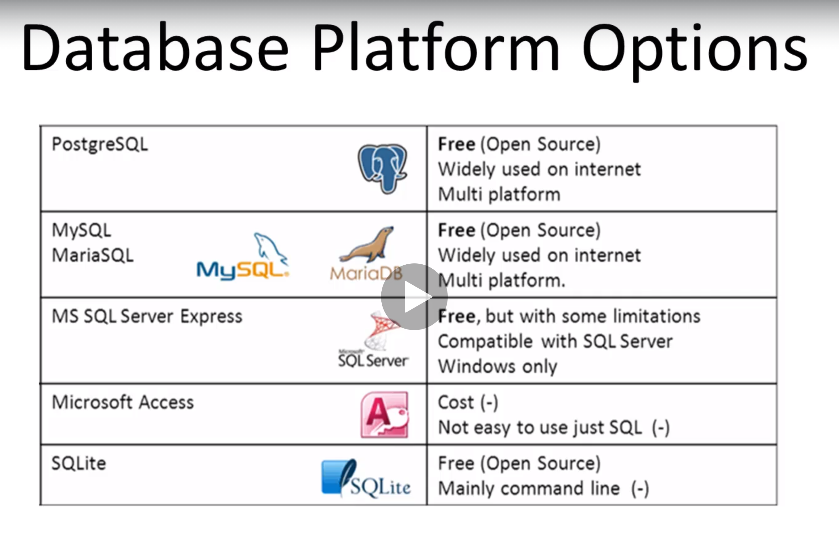
DataBase Platform Options
There are many options when it comes to choosing your next Database.

